Slide 1
Vocabulary Level G
Unit 4

Slide 2
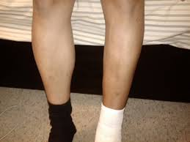
Atrophy
Connotation: Negative
Etymology: Greek, equivalent to átroph (os); a not, troph fed

Slide 3
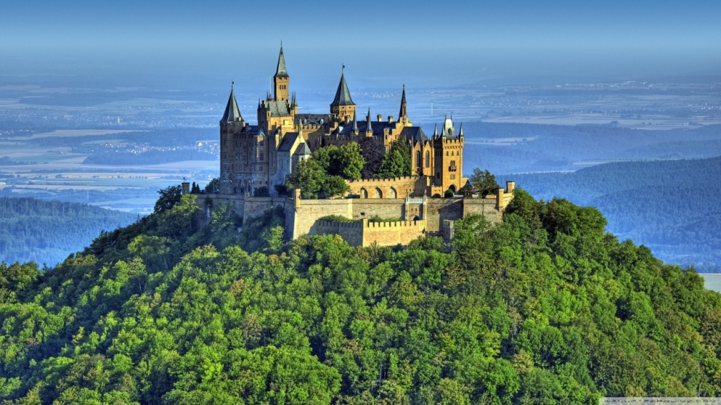
Bastion
Connotation: Positive
Etymology: Upper Italian bastí, from bastille, fortress

Slide 4
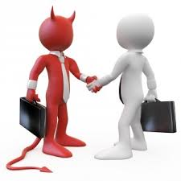
Concord
Connotation: positive
Etymology: Latin Concordia
con- with, join with; -cord heart

Slide 5
Consummate
Connotation: Positive
Etymology: Middle English consummat fulfilled, from Latin consummatus, past participle of consummare to sum up, finish,
Word Structure: from com- + summa sum

Slide 6
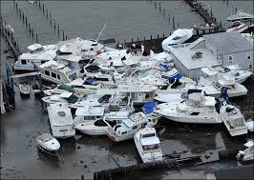
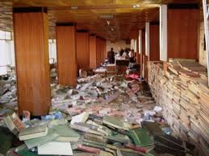
Disarray
Connotation: Negative
Etymology: Middle English dis- "lack of" + array “to prepare”

Slide 7
Frenetic
Connotation: Negative
Etymology: Greek phrenētikos, from phrenitis insanity, from phrēn mind

Slide 8
Exigency
Connotation: Neutral
Etymology: exigere "to demand, require; drive out"(see exact )
Word Structure: Ex meaning out of, away from, lacking, former ; -ence, -ency meaning action or process, quality or state

Slide 9
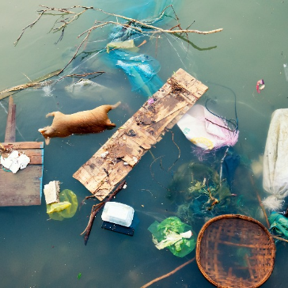
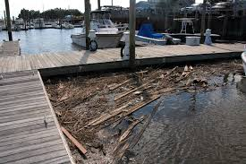
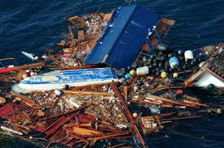
Flotsam
Connotation: Neutral
Etymology: Anglo-French floteson, derivative of floter to float

Slide 10
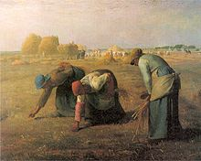
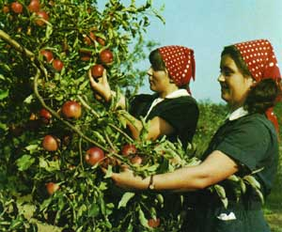
Glean
Connotation- Neutral
Etymology- 14c., from O.Fr. glener, from L.L. glennare "make a collection," from Gaulish glinn "he collects, gathers," Celt. glan "clean, pure"). Figurative sense was earlier in English than the literal one of "gather grain left by the reapers" (late 14c.).

Slide 11
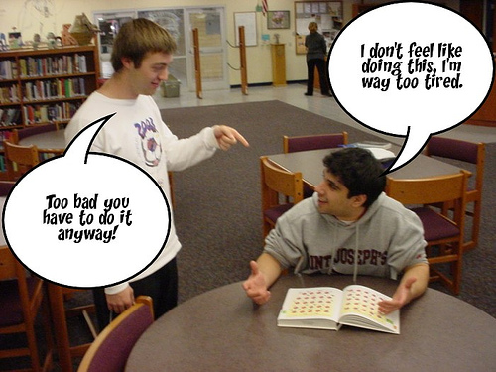
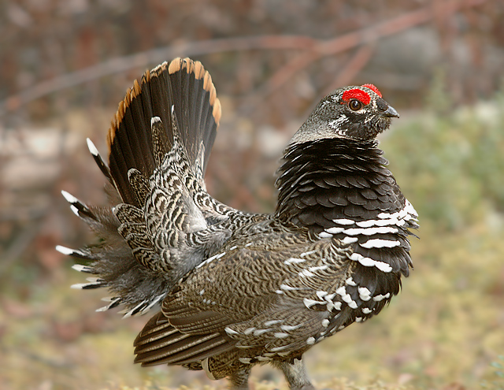
Grouse
Connotation- Negative
Etymology-1531, grows (pl., used collectively), of unknown origin, possibly from Latin or Welsh. "complain," 1887, British Army slang (first recorded by Kipling), of uncertain origin but perhaps from Norman Fr. dial. groucer, from O.Fr. groucier "to murmur, grumble," of imitative origin (cf. Gk. gru "a grunt," gruzein "to grumble").

Slide 12
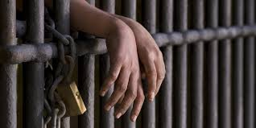
Incarcerate
Connotation: Negative
Etymology: Latin incarcerātus past participle of incarcerāre to imprison, equivalent to in- +carcer prison

Slide 13
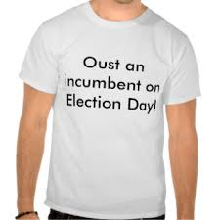
Incumbent
Connotation: neutral
Etymology: Latin incumbere to lie or lean upon, from in- ‘upon’ + a verb related to cubare ‘lie.’

Slide 14
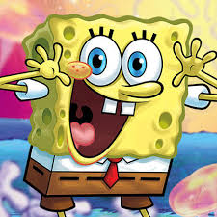
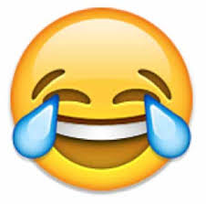
Jocular
Connotation: positive
Etymology: Latin joculāris, equivalent to jocul (us) little joke

Slide 15
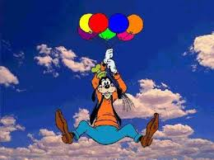
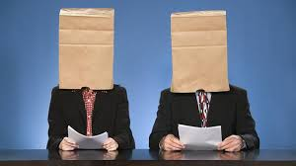
Ludicrous
Connotation: Negative
Etymology: Latin lūdicrus done in sport, from lūdus game; related to lūdere to play

Slide 16
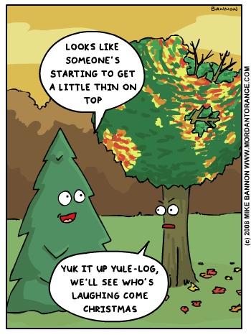
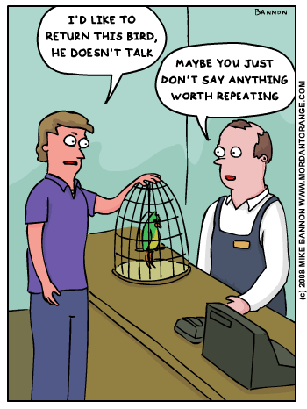
Mordant
Connotation: negative
Etymology: Latin mordere "to bite, bite into; nip, sting"

Slide 17
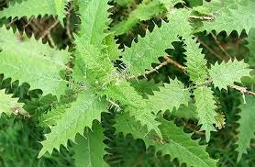
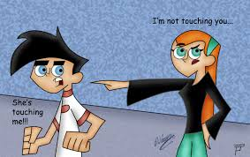
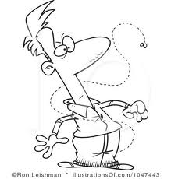
Nettle
Connotation: Negative
Etymology: stinging plant, Old English netele; "to beat with nettles," from nettle. Figurative sense of "irritate, provoke" is from 1560s

Slide 18
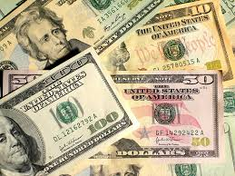
Pecuniary
Connotation: neutral
Etymology: Latin pecūniārius, derivative of pecūnia property, money

Slide 19
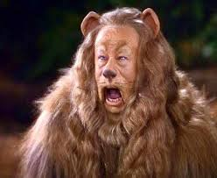
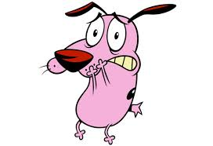
Pusillanimous
Connotation: Negative
Etymology: Latin pusillanimis petty-spirited,equivalent to Latin pusill (us) very small, petty + -anim(is) -spirited, -minded ( anim (us) spirit

Slide 20
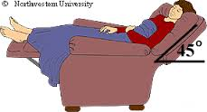
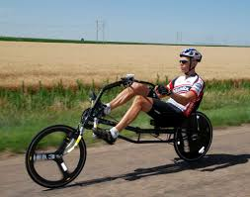
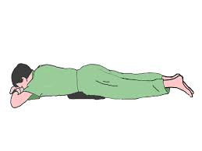
Recumbent
Connotation: Neutral
Etymology: Latin recumbere to lie back, equivalent to re- + cumb-, akin to cubāre to lie down

Slide 21
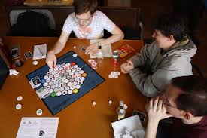
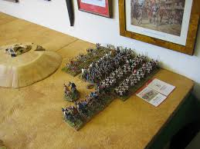
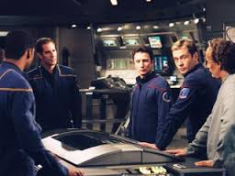
Stratagem
Connotation: Neutral
Etymology: Greek stratēgos a general, from stratos an army + agein to lead

