Slide 1
Level G
Unit 8
Vocabulary

Slide 2
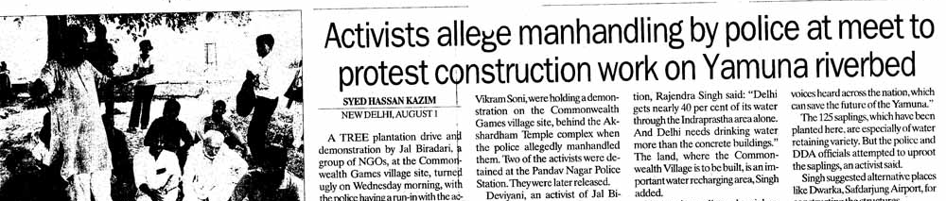
Allege
Connotation: Neutral
Etymology: Anglo-French aleger, Old French eslegier "to clear at law," from Latin ex-"out of" and litigare "bring suit" (see litigate);
however eslegier meant "acquit, clear of charges in a lawsuit." It somehow acquired the meaning of French alléguer, from Latin allegare "send for, bring forth, name, produce in evidence," from ad-"to" +legare "to depute, send"

Slide 3
Arrant
Connotation: Negative
Etymology: late 14c., variant of errant; at first merely derogatory, then (1550) acquiring a meaning "thoroughgoing, downright, notorious."

Slide 4
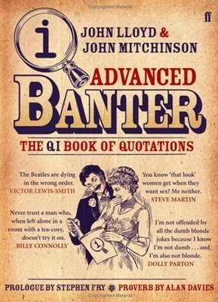
BADINAGE
Connotation: neutral
Etymology: French, equivalent to badin to joke, trifle

Slide 5
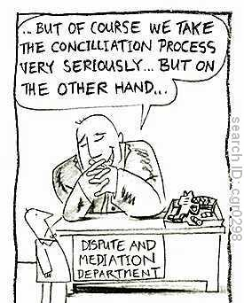
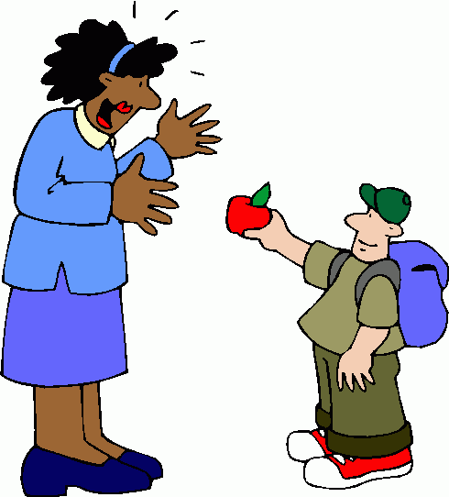
Connotation: positive
EtymoLOGY: latin “conciliatus” (past principle of conciliare, to bring together)
Conciliate

Slide 6
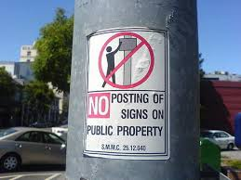
Countermand
Connotation: negative
Etymology: Middle English “countermauden”, suffix from Latin “mandare” to command
Word Structure: prefix counter- means “against”,

Slide 7
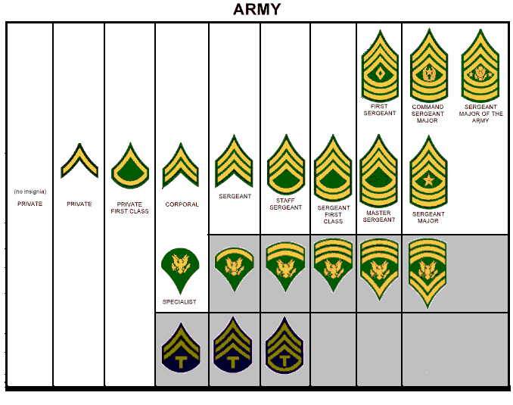

Echelon
Connotation: positive
Etymology: French échelon, literally: rung of a ladder, from Latin scala (scale)

Slide 8
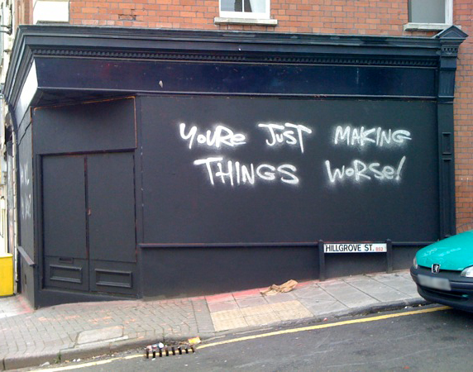
Exacerbate
Connotation: Negative
Etymology: Latin exacerbātus
(exasperate,provoke),
equivalent to ex- + acerbātus acerbate

Slide 9

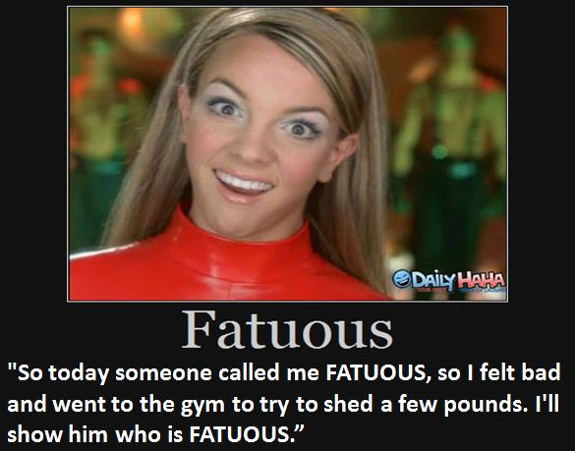
FATUOUS
Definition: (adj.) stupid or foolish in a self-satisfied way
Synonym: silly, vapid, inane
Antonym: sensible, intelligent, bright
No, you don't get fatuous by overeating or
stuffing yourself with carbs.
This word means "smugly or unconsciously foolish,
silly, stupid" (the way we feel when we overeat or
stuff ourselves with carbs).

Slide 10
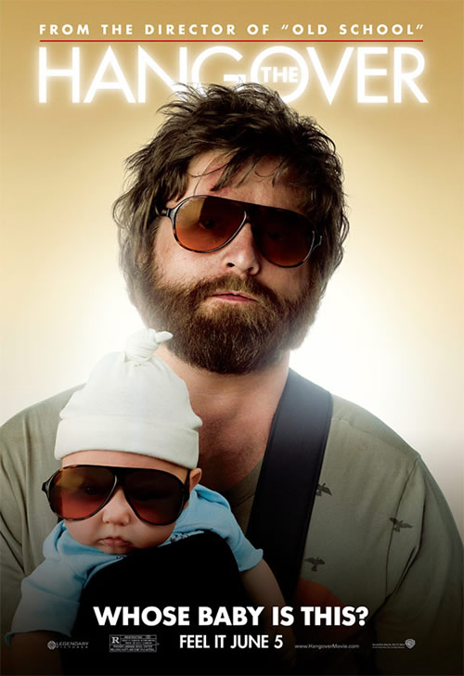
Fatuous
Connotation: Negative
Etymology:1625-35; < Latin fatuus silly, foolish, idiotic; see -ous

Slide 11
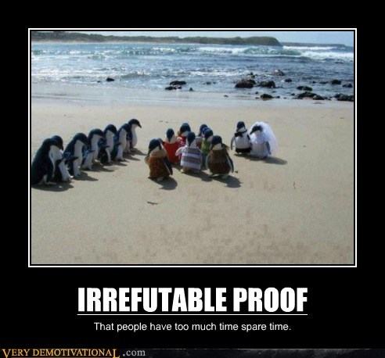
Irrefutable
Connotation: negative
Etymology: Latin
irrefutabilis, from
in- "not" + refutabilis
from refutare
(see refute )

Slide 12


JUGGERNAUT
Definition: (n.) a massive and inescapable force or object that crushes whatever is in it’s path
Synonym: force

Slide 13
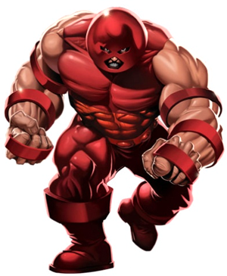
Juggernaut
Connotation: Negative
Etymology: Hindi Jagannāth < Sanskrit Jagannātha lord of the world (i.e., the god Vishnu or Krishna), equivalent to jagat world + nātha lord

Slide 14
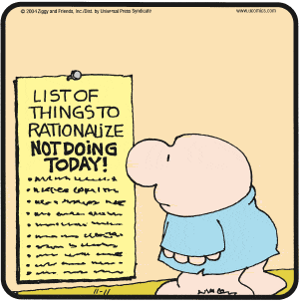
LACKADAISICAL
Definition: (adj.) lacking spirit or interest, halfhearted
Synonym: listless, indifferent, lax
Antonym: energetic, wholehearted

Slide 15
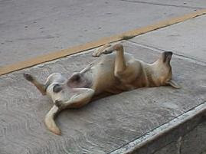
Lackadaisical
Etymology: from interjection lackadaisy "alas, alack" (1748), an alteration of lack-a-day (1690s),from alack the day (1590s). Hence, "given to crying 'lack-a-day,' vapidly sentimental." Sense probably altered by influence of lax.
Connotation: Negative

Slide 16
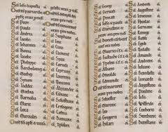
Litany
Connotation: Neutral
Etymology: Medieval Latin litanīa from Late Greek litaneia prayer, ultimately from Greek litē entreaty

Slide 17
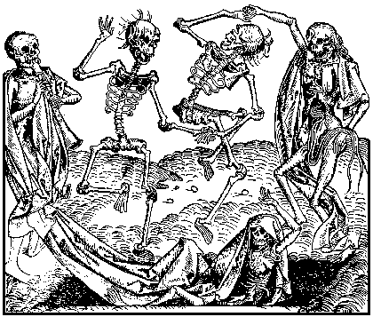
MACABRE
Connotation: negative
Etymology: Old French danse macabre dance of death, probably from macabé relating to the Maccabees, who were associated with death because of the doctrines and prayers for the dead in II Macc. (12:43–46)

Slide 18
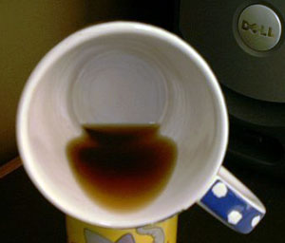
PAUCITY
Connotation: negative
Etymology: Latin paucitās scarcity, from paucus few

Slide 19
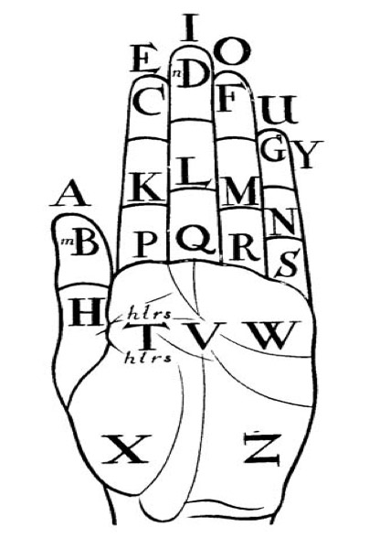
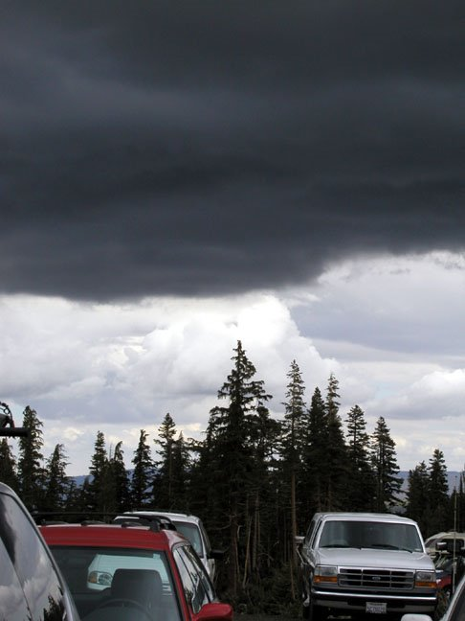
PORTEND
Connotation: negative
Etymology: Latin portendere to indicate, foretell; related to prōtendere to stretch out

Slide 20
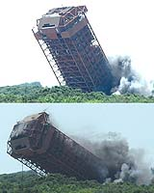
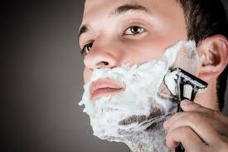
RAZE
Connotation: negative
Etymology: alteration of racen "pull or knock down" (a building or town), from earlier rasen (14c.) "to scratch, slash, scrape, erase," from Old French raser "to scrape, shave"

Slide 21
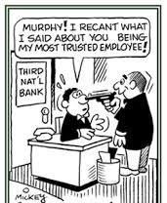
RECANT
Connotation: negative
Etymology: Latin recantāre to sing again, from re- +cantāre to sing

Slide 22
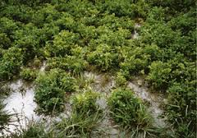
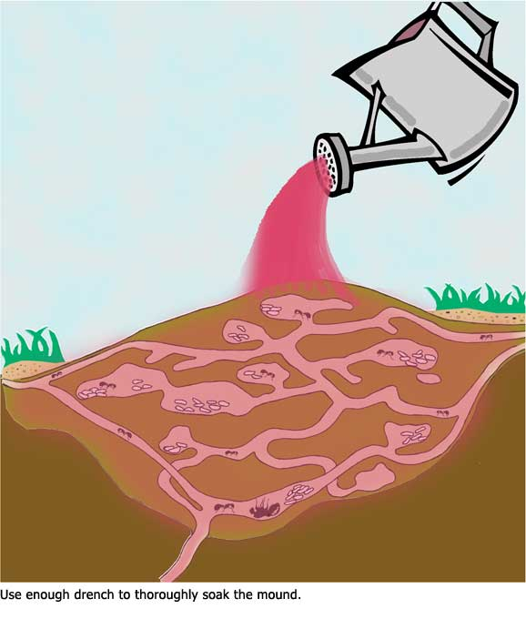
SATURATE
Connotation: neutral
Etymology: Latin saturāre, from satur sated, from satis enough

Slide 23

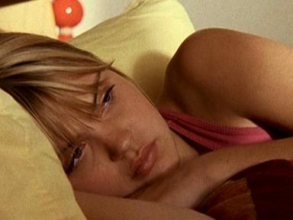
SATURNINE
Connotation: negative
Etymology: Middle English Saturne (see Saturn ) Medieval physiology believed these characteristics to be caused by the astrological influence of the planet Saturn, which was the most remote from the Sun (in the limited knowledge of the times) and thus coldest and slowest in its revolution.

Slide 24
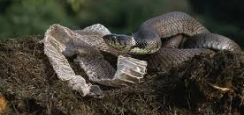
SLOUGH
Connotation: neutral
Etymology: Middle English slughe, slouh skin of a snake

