Slide 1
Vocabulary Unit 9

Slide 2
Acclamation
Connotation: Positive
Etymology- Latin acclamatio "a calling, exclamation, shout of approval," ad- "toward" + clamare "cry out" (see claim).

Slide 3
Bucolic
Connotation: Positive
Etymology: Greek boukolikós rustic, equivalent to boukól herdsman (boûs ox + -kolos keeper)

Slide 4
Calumniate
Connotation: Negative
Etymology: Latin calumniātus to accuse falsely, trick

Slide 5
Chary
Connotation: Neutral
Etymology: Old English cearig; related to caru care, Old High German charag sorrowful

Slide 6
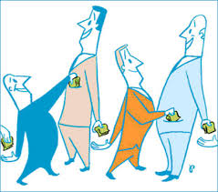
Collusion
Connotation: Negative
Etymology: Latin collusionem "act of colluding," from com- "together" +ludere "to play," from ludus "game"

Slide 7
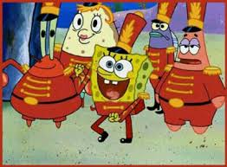
DILETTANTE
CONNOTATION: NEGATIVE
ETYMOLOGY: 1733, borrowing of It. dilettante "lover of music or painting," from dilettare "to delight," from L. delectare (see delight ).
Originally without negative connotation, "devoted amateur," the pejorative sense emerged late 18c. by contrast with professional.

Slide 8
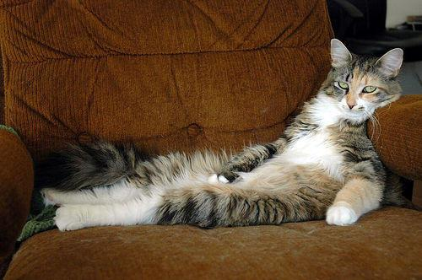
Imperturbable
Connotation: neutral
Etymology: Latin in-+ perturbare to perturb
Word structure: prefix im- means “not” or “in”; suffix able- meaning “able to be”

Slide 9
Increment
Connotation: neutral
Etymology: Latin incrementum, from increscere to increase
Word Structure: prefix in- means “into”; noun suffix ment- means the action or process of doing something

Slide 10
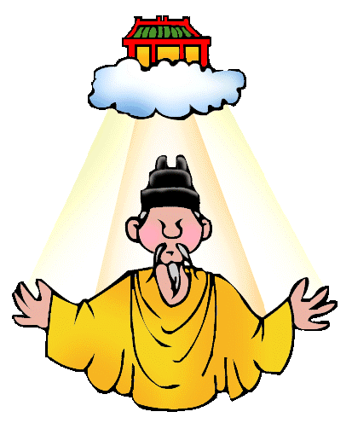
Mandate
Connotation: neutral
Etymology: Latin mandātum,
to commission, literally, to give into
(someone's) hand.
Word structure: Latin root word man means “hand.”

Slide 11
Paltry
Connotation: Negative
Etymology: German paltrig ragged, equivalent to*palter rag

Slide 12
Paroxysm
Etymology:
M.Latin paroxysmus "irritation, fit of a disease,"
from Gk. paroxynein "to irritate, goad," from para- "beyond" + oxynein "sharpen, goad," from oxys "sharp, pointed
Connotation: Negative

Slide 13
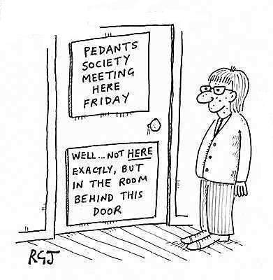
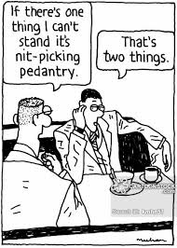
Pedantry
Connotation: Negative
Etymology: Italian pedanteria, from pedante teacher

Slide 14
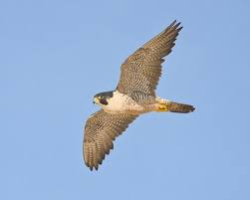
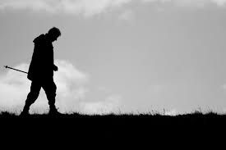
Peregrination
Peregrine Falcon
Connotation: Neutral
Etymology: Latin peregrinationem "a journey, a sojourn abroad," figuratively "to roam about, wander," from peregrinus "from foreign parts, foreigner," from peregre "abroad," properly "from abroad, found outside Roman territory," from per-+ agri, "field, territory, land, country"

Slide 15
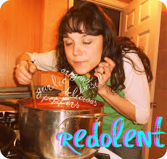
Redolent
Connotation: Positive
Etymology: Latin redolens smelling (of), from redolēre to give off an odor, olēre to smell

Slide 16
Refulgent
Connotation: Positive
Etymology: Latin refulgēre to shine brightly, from re- +fulgēre to shine

Slide 17
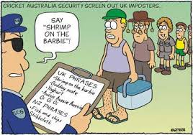
Shibboleth
Connotation: Neutral
Etymology: Hebrew, literally: ear of grain; the word issued in the Old Testament by the Gileadites as a test-word for the Ephraimites, who could not pronounce the sound sh (Judges 12:4-6)

Slide 18
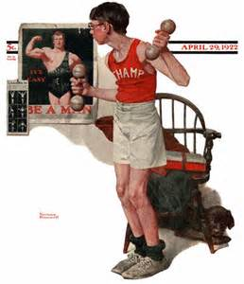
Tyro
Connotation: Neutral
Etymology- Medieval Latin tyro, variant of Latin tiro "young soldier, recruit, beginner"

Slide 19
Unremitting
Connotation: negative
Etymology: from un- "not" + remittere to send back, let go back, concede, allow

Slide 20
Vacillate
Connotation: negative
Etymology: Latin vacillatus, "sway to and fro; hesitate.”Meaning "to waver between two opinions or courses" is recorded from 1620s.

Slide 21
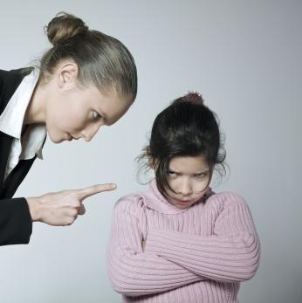
Vituperative
Connotation: negative
Etymology: Latin vituperāre to blame, from vitium a defect + parāre to make

