Slide 1
Writer’s Workshop: Organization
Claim statement, topic sentences, transition words and phrases, echo words

Slide 2
Take a look at the standards for ORGANIZATION.
College Board:
Use logical organization, enhanced by specific techniques to increase coherence, such as repetition, transitions, and emphasis.
Georgia Standards of Excellence:
Introduce a topic; organize complex ideas, concepts, and information so that each new element builds on that which precedes it to create a unified whole.
Use appropriate and varied transitions and syntax to link the major sections of the text, create cohesion, and clarify the relationships among complex ideas and concepts.

Slide 3
Building blocks of ORGANIZATION
TOPIC SENTENCES
Appear near the beginning of the body paragraphs
Establish the main idea of the paragraph they introduce
Extend the claim statement
Echoes the language of the prompt
CLAIM STATEMENT
Appears near the end of the introductory paragraph
Establishes the main idea of the essay as a whole
Is arguable (someone could logically argue a different side or different approach)
Uses the language of the prompt
Addresses all parts of the prompt

Slide 4
Glue that binds ORGANIZATION
ECHO WORDS
Recur in a sentence or paragraph to establish cohesion
Synonyms
Repetition
Polyptoton—I dreamt a dream; Choosy moms choose Jiff; To imagine the unimaginable is the highest use of the imagination.
TRANSITION WORDS AND PHRASES
Establish relationships among ideas and words
Agreement, addition, similarity
Opposition, limitation, contradiction
Cause, condition, purpose
Example, support, emphasis
Effect, consequence, result
Conclusion, summary, restatement
Time, chronology, sequence
Space, location, place

Slide 5
Writer’s Workshop: Selection of Detail
Evidence, analysis

Slide 6
Take a look at the standards for DETAIL.
College Board:
Use a balance of generalization and specific illustrative detail.
Identify and explain an author’s use of rhetorical strategies and techniques.
Georgia Standards of Excellence:
Develop the topic thoroughly by selecting the most significant and relevant facts, extended definitions, concrete details, quotations, or other information and examples appropriate to the audience’s knowledge of the topic.

Slide 7
Which DETAILS should I add?
ANALYSIS OF EVIDENCE
Explains why the evidence serves as an example of the topic
Implication
Consequence
Importance
EVIDENCE FROM THE TEXT
Quotes
Paraphrases
Examples
Description
illustration

Slide 8
LEAD-INS for quotations
vx “blended” vx
Use to blend a few words from the text into your own sentence. EX. John, a soldier “beloved by all,” lies dying in Alcott’s portrayal of a Civil War hospital.
Use a full sentence to set up a quote equal in importance to or used as an example of the lead-in.
EX: Alcott describes her pitiful duty as a nurse: “Now I knew that to him, as to so many, I was the poor substitute for mother, wife, or sister, and in his eyes no stranger, but a friend.”
Sentence:
Somebody says,
Use to introduce the author’s or a character’s words.
EX: Heartbreakingly, John asks, “This is my first battle; do they think it's going to be my last?"

Slide 9
Writer’s Workshop: Diction
Purposeful and vivid vocabulary, active verbs

Slide 10
Take a look at the standards for DICTION.
College Board:
Control a wide-ranging vocabulary used appropriately and effectively.
Georgia Standards of Excellence:
Use precise language, domain-specific vocabulary, and techniques such as metaphor, simile, and analogy to manage the complexity of the topic.

Slide 11
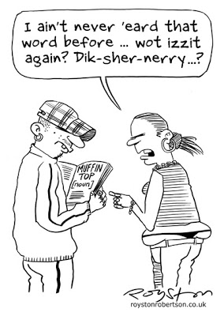
Add purposeful DICTION
PURPOSEFUL DICTION
Words set the tone and mood
Seek words that convey the exact meaning of your sentences
Consider connotation as well as denotation
Use purposeful vocabulary to decrease wordiness
VIVID VOCABULARY
Replace AM, ARE, IS, WAS, WERE
Replace SAYS
Eliminate VERY, REALLY, MANY
Avoid informal, slang, or general words. Replace with formal, appropriate, specific words.

Slide 12
Writer’s Workshop: Syntax
Varied sentence length and structure, reduced wordiness

Slide 13
Take a look at the standards for SYNTAX.
College Board:
Master a variety of sentence structures, including appropriate use of subordination and coordination.
Georgia Standards of Excellence:
Use appropriate and varied syntax to clarify the relationships among complex ideas and concepts.

Slide 14
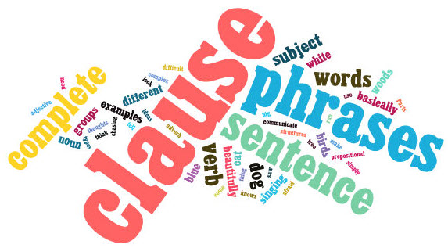
Vary your sentences.
SENTENCE STRUCTURES
Simple
Compound
Complex
Compound-Complex
SENTENCE BEGINNINGS
Adverb
Adjective
Prepositional phrase
Verbal phrase
SENTENCE PATTERNS
Cumulative
Periodic

